Slide 1
Circular Queue

Slide 2
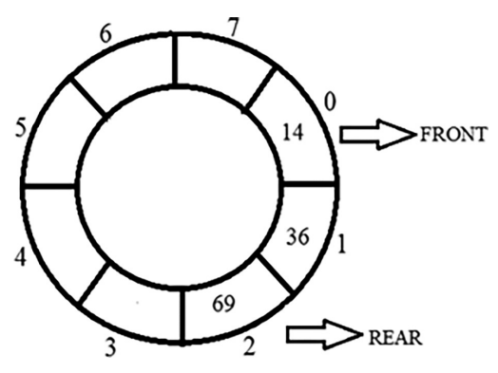
Queue

Slide 3
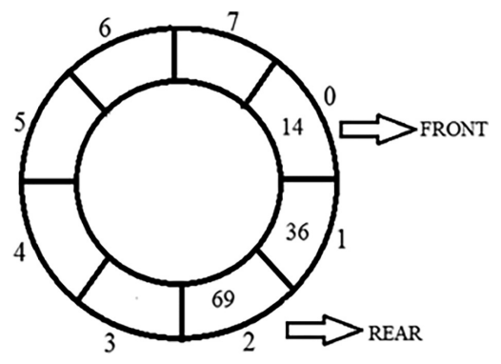
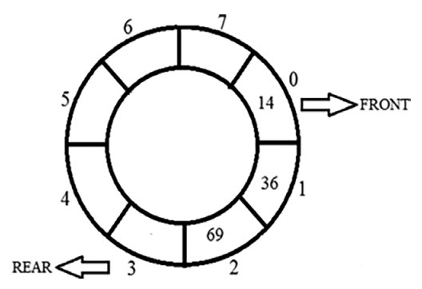
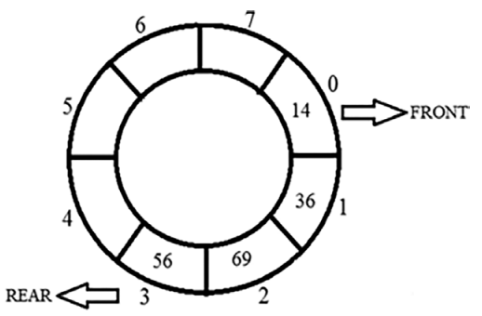
Inserting an Element in a Circular Queue

Slide 4
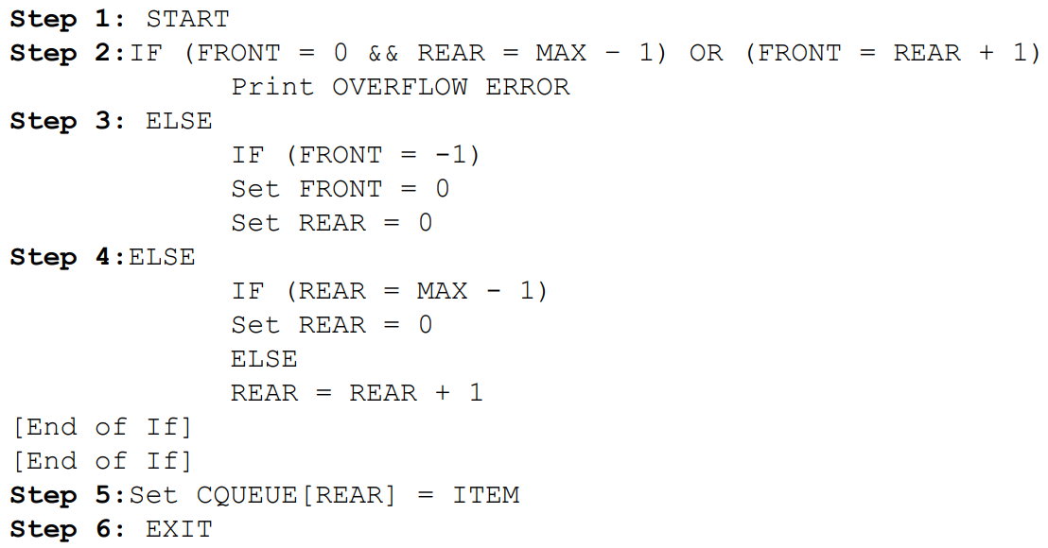
Algorithm for Inserting an Element

Slide 5
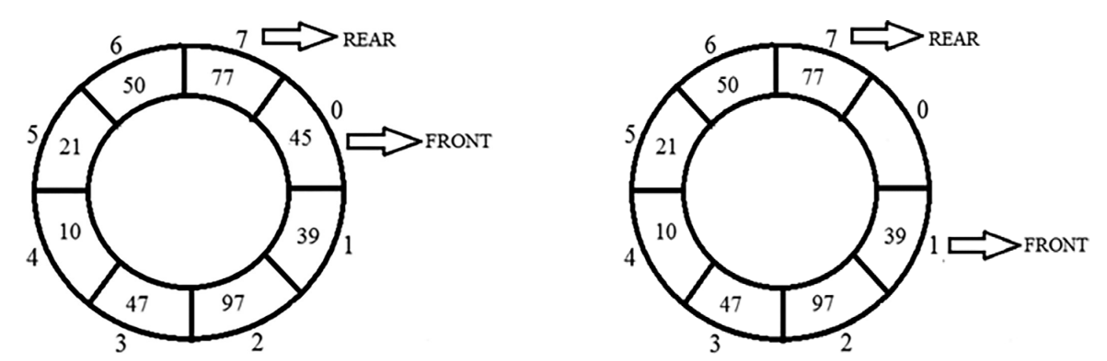
Deleting an Element in a Circular Queue

Slide 6
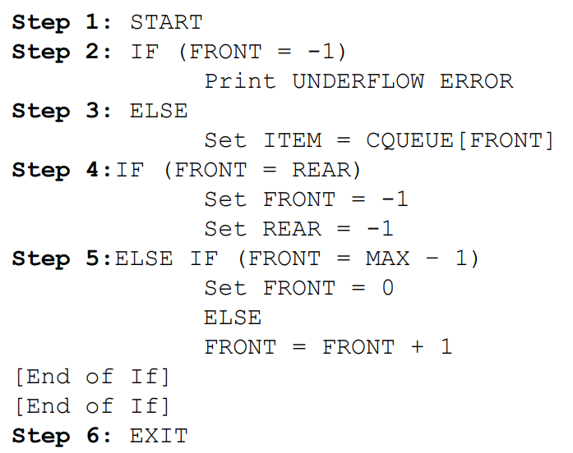
Algorithm for Deleting an Element

